Slide 1
Information Processing Techniques
Week 01
Abeeha Sattar

Slide 2
Let’s Introduce Ourselves
Name: Abeeha Sattar
Qualifications: MS(CS) from IBA (2020), BS(CS) from FAST-NUCES (2016)
Experience: Worked in Systems Ltd. for about 1.5 years.
Courses Taught: IPT, SDA, SCD, OOP-Lab
Tell me… your name, hobbies , your field of interest, and
your expectations from this course.
Don’t worry I won’t ask about your GPA!

Slide 3
Consultation Hours
Faculty Offices opposite to CS Secretariat, Room # 8
Monday: 8:00pm - 4:00pm
Friday: 8:00pm - 4:00pm
Do email me before visiting!
Email: abeeha.sattar@nu.edu.pk

Slide 4
Pre- Requisites
The course assumes that you have prior knowledge on the following:
Programming
Data Structures
Database Servers
Writing Queries

Slide 5
Course Outline
- You may find the course outline on Google Classroom.
- Assignments:
Assignment # 1 – Week 3
Assignment # 2 – Week 7
Assignment # 3 – Week 12
- Project:
Project Proposal – Week 2
Project Prototype – Week 5
Project API – Week 10
Project Presentations and Demos – Week 16

Slide 6
Grading Scheme
Programming Assignments 10 %
Labs 3 %
Project 12 %
Midterms (2) 25 %
Final 50 %

Slide 7
Assignments Policies
No late submissions
Plagiarism on 1st assignment: 0 for that question
Plagiarism on 2nd assignment: 0 for that assignment

Slide 8
Classroom Policies
Attendance:
Should have 80% attendance.
Do not come to me for attendance related issues. If I have marked it incorrectly, make sure to get it fixed on a weekly basis.
Marks/Weightage:
Do not come to me for marks related issues at the end of the semester. All emails regarding “please give me X weightage” will be ignored.
Class Behavior:
A blacklist will be maintained for students that misbehave/ do not pay attention during class. …Consequences will be?

Slide 9
Reference Book
Pro C# 7 With .Net and .Net Core
by Andrew Troelsen and Philip Japikse
(Apress Publications)

Slide 10
Tools Required
Visual Studio (VS 2017/2019/Code)
Windows Application
Windows Service
Web Application (ASP.Net)
Web Service (ASMX)
WCF
WEB API
SQL Server ( SQL Server 2014+ Professional or Enterprise Edition)

Slide 11
What is an Information Processing Technique?
Choosing technology efficiently based on the scenario under consideration.
Examples include, choosing from:
Different sorting algorithms
Databases, types of joins
Different Web Services, WCF or Web APIs
Notes:
WCF = Windows Communication Foundation
Framework

Slide 12
The .NET Framework
VB
C++
C#
JScript
…
Common Language Specification
ASP.NET: Web Services
And Web Forms
Windows
Forms
Visual Studio .NET
ADO.NET Data and XML
Base Class Library
Common Language Runtime
Notes:
OPTIONAL SLIDE, USE IF AUDIENCE HAD NO PREVIOUS EXPOSURE TO .NET
KEY MESSAGE:
The .NET Framework is a complete set of technologies that makes it easy to create the next generation of applications. And VS.NET is the set of tools that takes advantage of this infrastructure.
SLIDE SCRIPT:
The .NET framework exposes numerous classes to the developer. These classes allow the development of rich client applications and Web based applications alike. In the above slide these classes have been divided into 4 areas.
ASP.NET provides the core Web infrastructure such as Web Forms for UI based development and Web Services for programmatic interface development,
User interface development on the Windows platform can be done using Windows Forms
ADO.NET and XML provide the functionality for data access.
Finally, the core base classes provide infrastructure services such as security, transaction management etc.
SLIDE TRANSISTION: Common Language Runtime

Slide 13
Common Language Runtime
The primary role of the CLR is to locate, load, and manage .NET objects.
The CLR also takes care of a number of low-level details such as memory management, application hosting, coordinating threads, and performing basic security checks.
Common Classes for all Languages
Common Types for all Languages
Runtime Controls Compilation to Machine Code
Assemblies
Notes:
Object interaction across languages
-inheritance
-functions
Components and Metadata

Slide 14
Common Language Runtime
Runtime uses metadata to:
Locate and load classes
Resolve method invocations
Generate native code
Runtime automatically handles object layout and manages references in your code
Notes:
Platform, Language and Architectural independency
The key components of CLR includes the following:
Class Loader - Used to load all classes at run time.
MSIL to Native code - The Just In Time (JTI) compiler will convert MSIL code into native code.
Code Manager - It manages the code at run time.
Garbage Collector - It manages the memory. Collect all unused objects and deallocate them to reduce memory.
Thread Support - It supports multithreading of our application.
Exception Handler - It handles exceptions at run time.

Slide 15
Common Type System
Describes all data types & programming constructs
Describes how entities interact with each other
Describes how to represent them in .NET metadata format

Slide 16
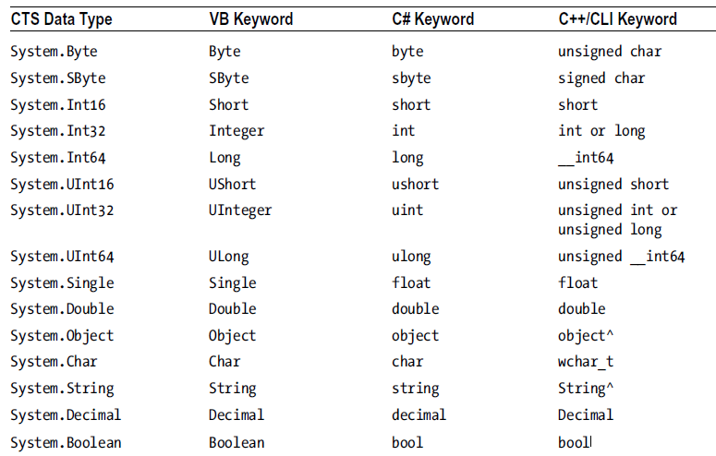

Slide 17
Common Language Specification
CLS is a related specification that defines a subset of common types and programming constructs that all .NET programming languages can agree on.
If you build .NET types that expose only CLS-compliant features, you can rest assured that all .NET-aware languages can consume them.
Notes:
one rule is that you cannot use multiple inheritance within .NET Framework
The CLS is a set of rules that describe in vivid detail the minimal and complete set of features a given .NET-aware compiler must support to produce code that can be hosted by the CLR, while at the same time be accessed in a uniform manner by all languages that target the .NET platform.

Slide 18
Base Class Libraries
Available for all .NET languages.
Encapsulate various primitives such as threads, file input/output (I/O), graphical rendering systems, and interaction with various external hardware devices
It also provides support for a number of services required by most real-world applications.
Notes:
FCL == Framework Class Library
Base / user defined data types
Exception handling
Input/ output
Data access
Support for:
Client based applications
Web based applications
Web services

Slide 19
The CLR, CTS, CLS, and Base Class Library Relationship

Slide 20
C# Features
No pointers required
Automatic garbage collection
Formal constructs for classes, interfaces, structures, enumerations and delegates
Operator overloading
Support for attribute-based programming
[declarative tag]

Slide 21
Managed & Unmanaged Code
C# language can be used to only build software that is hosted under the .NET runtime
Any code targeting the .NET runtime is managed code.
Code that cannot be directly hosted by the .NET framework is unmanaged code.
A binary unit that contains managed code is an assembly.

Slide 22
An Overview of .NET Assemblies
When a *.dll or *.exe has been created using a .NET-aware compiler, the binary blob is termed an assembly
While they have the same extension as Windows binaries, they are not internally similar.
.NET binaries do not contain platform-specific instructions, but platform-agnostic intermediate language (IL) and metadata
Notes:
For example, if you have a class named SportsCar, the type metadata describes details such as SportsCar’s base class, specifies which interfaces are implemented by SportsCar (if any), and gives full descriptions of each member supported by the SportsCar type. .NET metadata is always present within an assembly and is automatically generated by a .NET-aware language compiler.
Finally, in addition to CIL and type metadata, assemblies themselves are also described using metadata, which is officially termed a manifest.
The manifest contains information about the current version of the assembly, culture information (used for localizing string and image resources), and a list of all externally referenced assemblies that are required for proper execution.

Slide 23
An Overview of .NET Assemblies
C#
Source Code
C# Compiler
PERL .NET
Source Code
PERL .NET Compiler
IL and
Metadata
(*.dll or *.exe)
COBOL .NET
Source Code
COBOL .NET Compiler
C++/CLI
Source Code
C++/CLI Compiler

Slide 24
An Overview of .NET Assemblies
Similar to Java Bytecode (not platform specific instructions)
Assemblies contain:
MSIL
Metadata
Details of all the “types” within the binary
Manifest
Describes the assembly
List of external dependencies

Slide 25
Benefits of CIL/IL
Language integration
Each .NET aware compiler produces nearly identical CIL
Platform-agnostic
Single code base

Slide 26
.NET Framework and CLR CLR Execution Model
VB
C#
C++
Compiler
Compiler
Compiler
Unmanaged Component
Assembly IL Code
Assembly IL Code
Assembly IL Code
C
Common Language Runtime
JIT Compiler
Native Code
Operating System Services
Notes:
Obviously before the IL code can be executed it must be converted into native binary instructions. Converted? Does this mean interpreted? NO! The IL code is compiled and not thrown away. This means that next time the code is requested it is already in the form of machine instructions and thus this mechanism in the log run is far more efficient than an interpreter for example.
The compilation is carried out by a JIT (Just In Time) compiler. Does the compiler compile all of the code in one go? The answer to this question is NO. If this approach was taken there would be a long delay during the applications initialisation, and realistically not all the code within the module will be required in one go. Instead, when the code is loaded a ‘stub’ is connected to each method. When a method is called via the stub the compiler generates the binary native code. This mechanism goes a long way to describing why the compiler is called a ‘JIT’ compiler.
Compiled code is only saved in the same process (run) of an application. And even then it's not guaranteed. we do what's called "code-pitching" which means we through away cold (or little used) JITed code if memory pressure requires it. We do persisted JITed code in the install time scenario.
The benefit for to this system is obviously portability

Slide 27
Understanding the Common Type System
Assemblies can contain distinct types
In .NET, “types” refer to members from the set of:
Class
Interface
Structure
Enumeration
Delegate

Slide 28
CTS Class Types
.NET languages support Class types.
Classes may have:
Constructors, properties, methods, events & data points
In C#, it is described by the class keyword.
class Calc { public int Add(int x, int y) { return x + y; } }

Slide 29
CTS Class Types
Single inheritance
Multiple interface implementation
Static and instance members
Nested types
Member access
Public, protected, private, internal, internal-protected, private-protected

Slide 30
CTS Interface Types
Named collection of abstract member definitions, which may be defined by the class/struct implementing them.
Defined by the interface keyword
Conventional naming: start with the capital letter I
public interface Idraw {
void Draw();
}

Slide 31
CTS Structure Types
A structure can be thought of as a lightweight class type having value-based semantics.
Best suited for modeling geometric and mathematical data.
Defined by struct
No inheritance
struct Point { public int xPos, yPos; //fields public Point(int x, int y) { xPos = x; yPos = y;} //constructors //functions public void PrintPosition() { Console.WriteLine("({0}, {1})", xPos, yPos); } }
Notes:
Stored in-line, not heap allocated
More efficient use of memory
No heap allocation, lesser need for garbage collection

Slide 32
CTS Enumeration Types
Programming construct that allow you to group name-value pairs
name: literal constant value: integer type [byte, Int32, UInt64]
enum CharacterType { Wizard = 100, Fighter = 200, Thief = 300 }

Slide 33
CTS Delegate Types
.NET equivalent of a type-safe, C-style function pointer
The key difference is that a .NET delegate is a class that derives from System.MulticastDelegate.
Delegates are critical when you want to provide a way for one object to forward a call to another object and provide the foundation for the .NET event architecture.
delegate int BinaryOp(int x, int y);

Slide 34
Language Features Type System
Value types
Directly contain data
Cannot be null
Reference types
Contain references to objects
May be null
int i = 123;
string s = “Hello World!”;

Slide 35
Language Features Type System
C# predefined types
Reference object, string
Signed sbyte, short, int, long
Unsigned byte, ushort, uint, ulong
Character char
Floating-point float, double, decimal
Logical bool
Predefined types are simply aliases for system-provided types
For example, int = System.Int32

Slide 36
Language Features Predicted Types
Boxing
Allocates box, copies value into it
Unboxing
Checks type of box, copies value out
int i = 123;
object o = i;
int j = (int)o;

Slide 37
Language Features Unified Type System
More on boxing and unboxing:
CLR boxes a value into System.Object and stores it in a managed heap.
Boxing is implicit, while unboxing is explicit

Slide 38
Namespace
A namespace is a grouping of semantically related types contained in an assembly or possibly spread across multiple related assemblies.
For example, the System.IO, System.Data, etc.
It is important to point out that a single assembly can contain any number of namespaces.

Slide 39
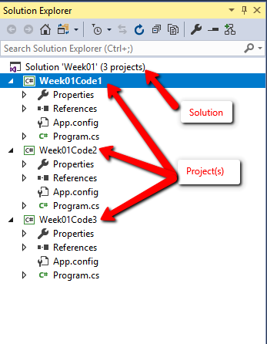
Solution v/s Project

Slide 40
Recap of OOP
Pillars of Object-Oriented Programming:
Inheritance
Encapsulation
Polymorphism
Abstraction
Notes:
Encapsulation v/s abstraction
Encapsulate hides variables or some implementation that may be changed so often in a class to prevent outsiders access it directly. They must access it via getter and setter methods.
Abstraction is used to hiding something too but in a higher degree(class, interface). Clients use an abstract class(or interface) do not care about who or which it was, they just need to know what it can do.

Slide 41
Access Specifiers
Public
Private
Protected
Internal
Protected Internal
Private Protected
Notes:
Internal : public within same assembly
protected internal The type or member can be accessed by any code in the assembly in which it is declared, or from within a derived class in another assembly.
private protected The type or member can be accessed only within its declaring assembly, by code in the same class or in a type that is derived from that class.
public class BaseClass { private protected int myValue = 0; }
public class DerivedClass1 : BaseClass {
void Access() {
BaseClass baseObject = new BaseClass();
// Error CS1540
baseObject.myValue = 5;
// OK, myValue = 5; } }
class DerivedClass2 : BaseClass {
void Access() {
// Error // myValue = 10; } }

Slide 42
C# Access Modifiers
 | Same Assembly |  | Different Assembly
 | Child Class | Via Object | Child Class | Via Object
Public | Y | Y | Y | Y
Private | N | N | N | N
Protected | Y | N | Y | N
Internal | Y | Y | N | N
Protected Internal | Y | Y | Y | N
Private Protected | Y | N | N | N

Slide 43
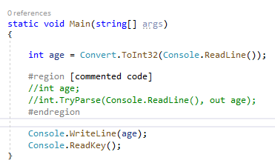
Basic Code and Syntax

Slide 44
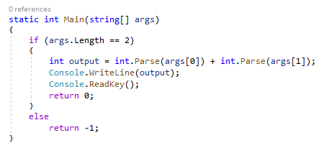
Command Line Arguments

Slide 45
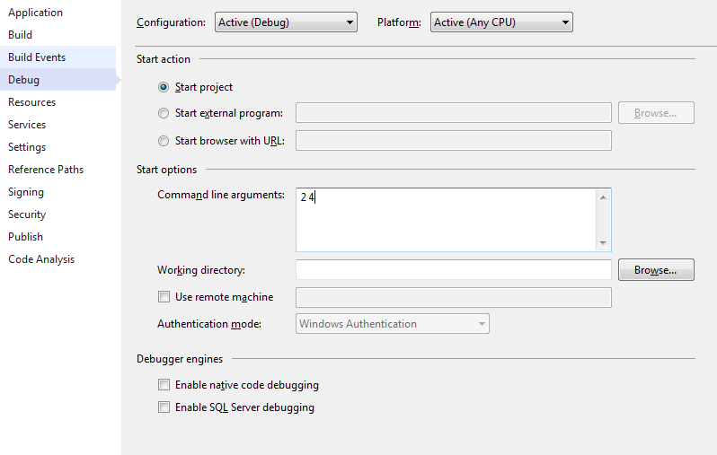
Command Line Arguments

Slide 46
Fin.

